Slide 1

APEX INSTITUTE OF TECHNOLOGY(CSE)
MINOR PROJECT

Slide 2

Traffic Automobile Counter
(using OpenCV and YOLO)
Mudit Sharma Pooja Jain
Chandigarh University, Chandigarh University,
Gharuan, India Gharuan, India
20BCS6542@cuchd.in 20BCS6551@cuchd.in

Slide 3
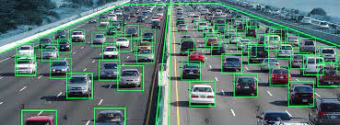
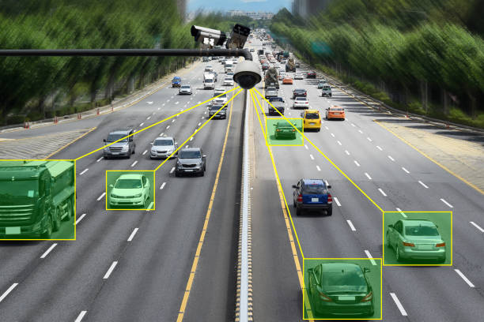
Introduction
Automatic traffic counters are devices used to count the number of vehicles passing through a particular area. They are commonly used in traffic studies and transportation planning.
YOLO (You Only Look Once) is a state-of-the-art object detection system that can identify objects in real-time with high accuracy and speed. It has been successfully applied in various fields, including autonomous driving, surveillance, and robotics.

Slide 4
Problem Statement
The main disadvantage of traditional traffic lights compared to YOLO traffic lights is that they are limited in their ability to respond to real-time changes in traffic patterns and conditions. Traditional traffic lights rely on pre-programmed timing sequences or sensors that detect the presence of vehicles or pedestrians to determine when to change the signal, which can lead to delays, congestion, and inefficient use of road space

Slide 5
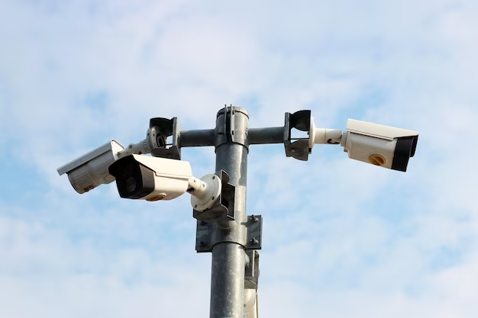
Problem Statement
Another disadvantage of traditional traffic lights is that they may not be able to detect and respond to non-motorized road users, such as cyclists and pedestrians, as effectively as YOLO traffic lights. This can lead to unsafe conditions for these vulnerable road users, who may not be given sufficient time to cross the street or who may be put at risk by drivers who are not aware of their presence.

Slide 6
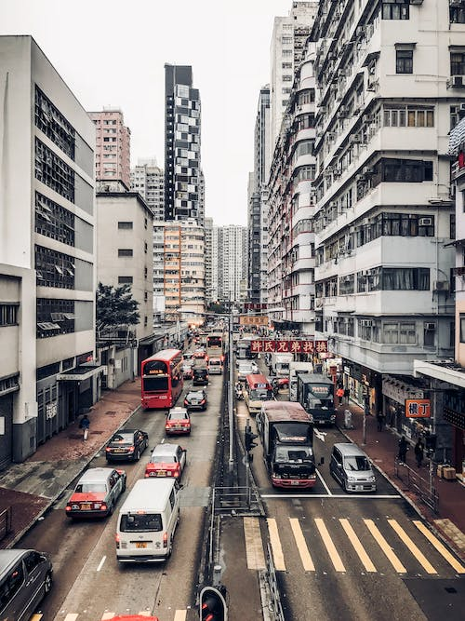
The YOLO Algorithm
The YOLO algorithm works by dividing an image into a grid and applying convolutional neural networks to each cell in the grid. Each cell predicts a fixed number of bounding boxes and their associated class probabilities.
During inference, YOLO applies non-maximum suppression to remove redundant detections and outputs the final set of bounding boxes and their associated class probabilities.
Problem Statement
Another disadvantage of traditional traffic lights is that they may not be able to detect and respond to non-motorized road users, such as cyclists and pedestrians, as effectively as YOLO traffic lights. This can lead to unsafe conditions for these vulnerable road users, who may not be given sufficient time to cross the street or who may be put at risk by drivers who are not aware of their presence.

Slide 7
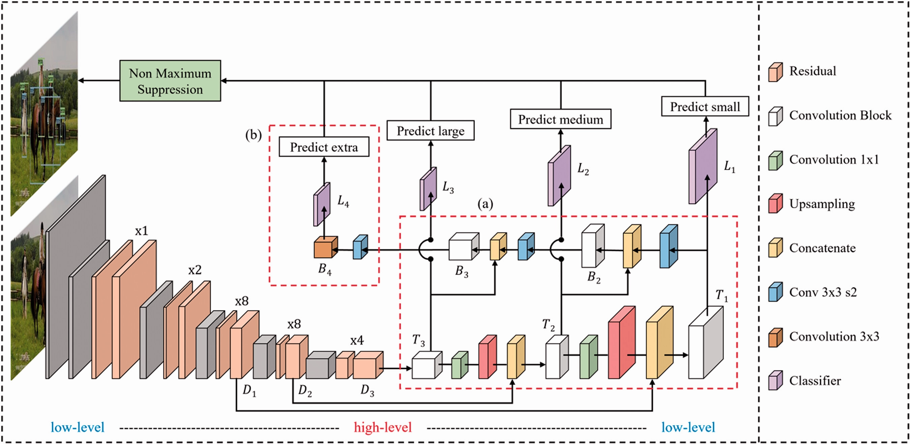
YOLO MODEL WORKING

Slide 8
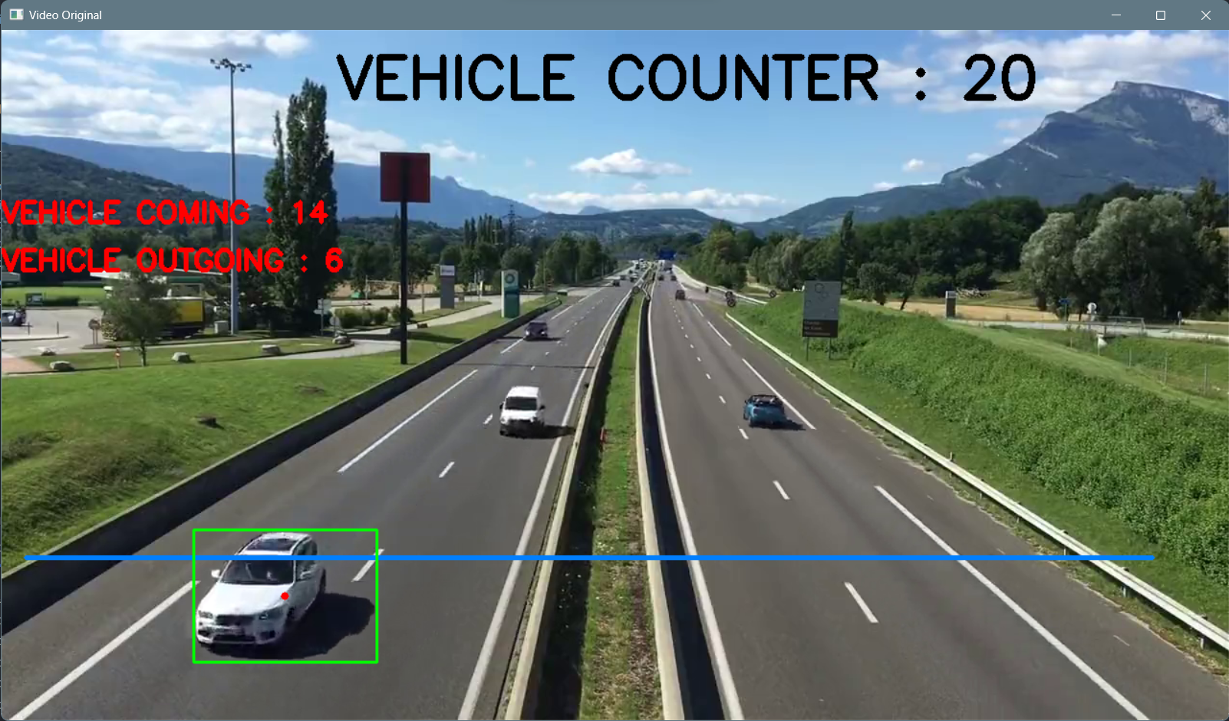
The Automatic Traffic Counter System
The automatic traffic counter system using YOLO consists of a camera mounted on a pole or structure overlooking the road. The camera captures images of the passing vehicles which are processed by the YOLO algorithm running on a computer.
The YOLO algorithm identifies the vehicles in the images and counts them. The count data can be stored locally or transmitted wirelessly to a central database for further analysis and processing.
Problem Statement
Another disadvantage of traditional traffic lights is that they may not be able to detect and respond to non-motorized road users, such as cyclists and pedestrians, as effectively as YOLO traffic lights. This can lead to unsafe conditions for these vulnerable road users, who may not be given sufficient time to cross the street or who may be put at risk by drivers who are not aware of their presence.

Slide 9
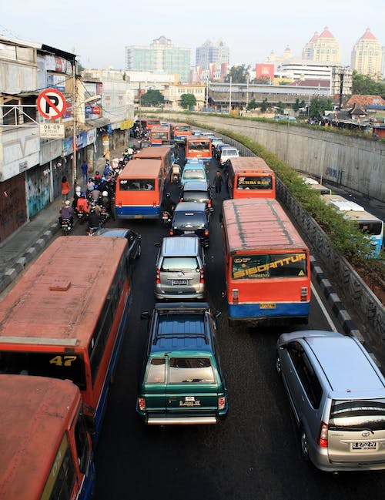
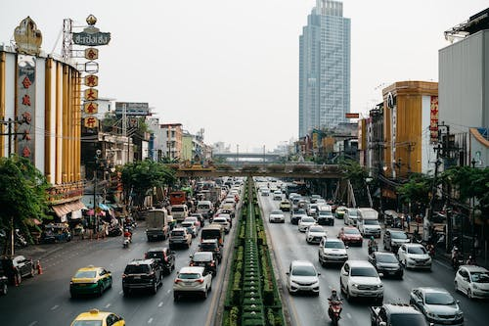
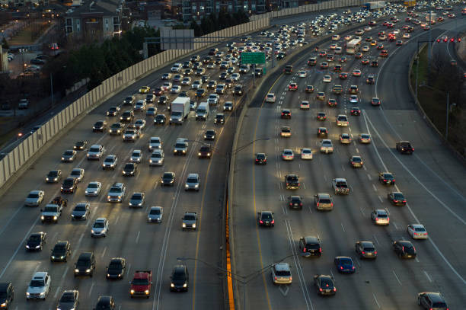
Problem Statement
Another disadvantage of traditional traffic lights is that they may not be able to detect and respond to non-motorized road users, such as cyclists and pedestrians, as effectively as YOLO traffic lights. This can lead to unsafe conditions for these vulnerable road users, who may not be given sufficient time to cross the street or who may be put at risk by drivers who are not aware of their presence.

Slide 10
Applications of the Automatic Traffic Counter Using YOLO
The automatic traffic counter using YOLO has numerous applications in transportation planning and management. It can be used to monitor traffic flow and congestion, identify high-traffic areas, and optimize traffic signal timing.
It can also be used to study the impact of new road infrastructure or public transportation systems on traffic patterns and volume.
Problem Statement
Another disadvantage of traditional traffic lights is that they may not be able to detect and respond to non-motorized road users, such as cyclists and pedestrians, as effectively as YOLO traffic lights. This can lead to unsafe conditions for these vulnerable road users, who may not be given sufficient time to cross the street or who may be put at risk by drivers who are not aware of their presence.

Slide 11
The Automatic Traffic Counter System
The automatic traffic counter system using YOLO consists of a camera mounted on a pole or structure overlooking the road. The camera captures images of the passing vehicles which are processed by the YOLO algorithm running on a computer.
The YOLO algorithm identifies the vehicles in the images and counts them. The count data can be stored locally or transmitted wirelessly to a central database for further analysis and processing.
Problem Statement
Another disadvantage of traditional traffic lights is that they may not be able to detect and respond to non-motorized road users, such as cyclists and pedestrians, as effectively as YOLO traffic lights. This can lead to unsafe conditions for these vulnerable road users, who may not be given sufficient time to cross the street or who may be put at risk by drivers who are not aware of their presence.

Slide 12
Conclusion
In conclusion, the automatic traffic counter using YOLO is a powerful tool for traffic monitoring and analysis. It combines the accuracy and speed of YOLO with the simplicity and cost-effectiveness of a camera and computer setup.
With its numerous applications in transportation planning and management, it has the potential to improve traffic flow, reduce congestion, and enhance overall transportation efficiency

